Slide 1
Chapter 7: Entity-Relationship Model

Slide 2
Case Study-1
The COMPANY database keeps track of a company's employees, departments, and projects. Suppose that after the requirements collection and analysis phase, the database designers provided the following description of the "miniworld"-the part of the company to be represented in the database:
1. The company is organized into departments. Each department has a unique name, a unique number, and a particular employee who manages the department. We keep track of the start date when that employee began managing the department. A department may have several locations.
2. A department controls a number of projects, each of which has a unique name, a unique number, and a single location.
3. We store each employee's name, social security number, address, salary, sex, and birth date. An employee is assigned to one department but may work on several projects, which are not necessarily controlled by the same department. We keep track of the number of hours per week that an employee works on each project. We also keep track of the direct supervisor of each employee.
4. We want to keep track of the dependents of each employee for insurance purposes. We keep each dependent's first name, sex, birth date, and relationship to the employee.

Slide 3
Designing the ER diagram
Step-1: Identify the entity sets and attributes
1.Department – dname, dnumber, locations
2.Project – pname, pnumber, location
3.Employee – ename, SSN, address, salary, sex, birth_date
4.Dependent (Weak entity set)– fname, sex, birth_date, relationship

Slide 4
Step-2: Identify the relationships, participation constraints and cardinality ratio
1.Manages – Employee and Department with attribute start_date, 1:1, Employee- partial, Department- total
2.Controls – Department and Project, 1:N, department-partial, Project-total
3. Works for – Employee and Department, N:1, Employee-total, Department-total
4.Works_on – Employee and Project with attribute hours_per_week, M:N, Employee –total, Project-total
5.Supervisor – Employee and Employee (supervised and supervise), M:1, supervised-total, supervise-partial
6.Dependent_of (identifying relationship) – Dependent and Employee, M:1, Dependent –total, Employee -partial

Slide 5
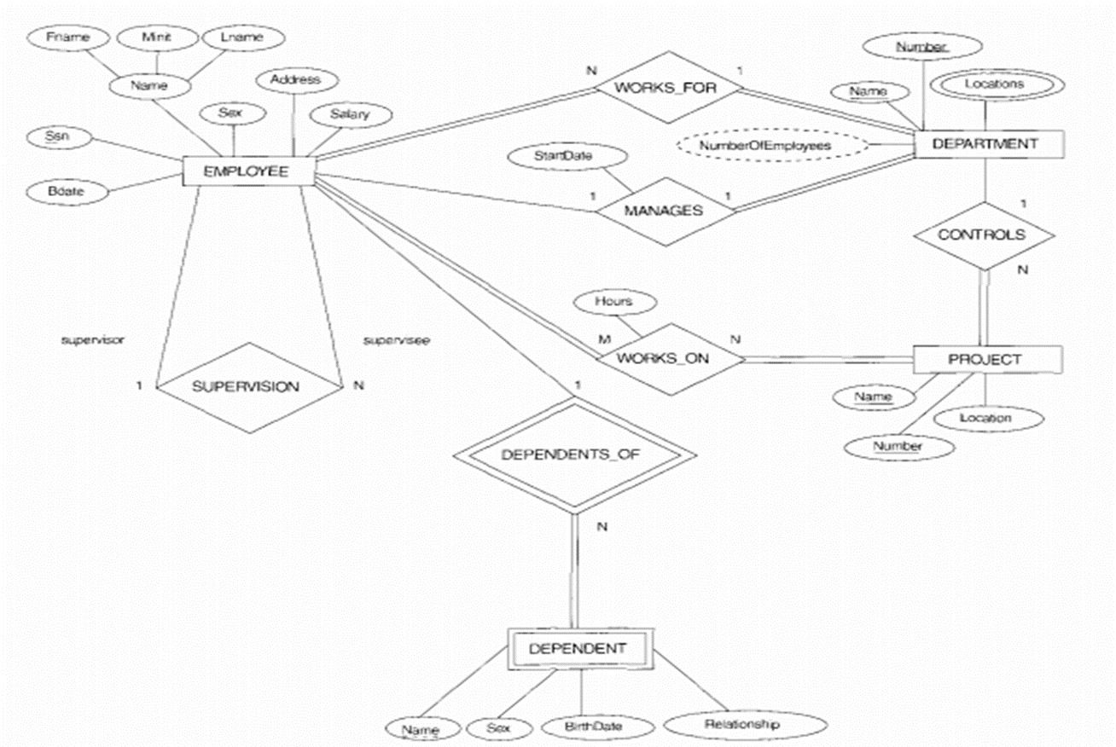

Slide 6
Extended E-R Features

Slide 7
Specialization
Top-down design process; we designate sub-groupings within an entity set that are distinctive from other entities in the set.
These sub-groupings become lower-level entity sets that have attributes or participate in relationships that do not apply to the higher-level entity set.
Depicted by a triangle component labeled ISA (e.g., instructor “is a” person).
Attribute inheritance – a lower-level entity set inherits all the attributes and relationship participation of the higher-level entity set to which it is linked.

Slide 8
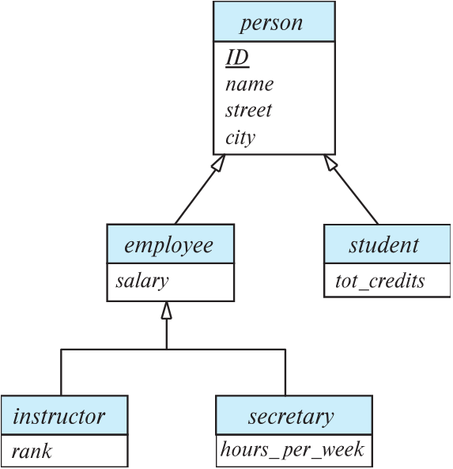

Specialization Example
Overlapping – employee and student
Disjoint – instructor and secretary
Total and partial

Slide 9
Generalization
A bottom-up design process – combine a number of entity sets that share the same features into a higher-level entity set.
Specialization and generalization are simple inversions of each other; they are represented in an E-R diagram in the same way.
The terms specialization and generalization are used interchangeably.

Slide 10
Completeness constraint
Completeness constraint -- specifies whether or not an entity in the higher-level entity set must belong to at least one of the lower-level entity sets within a generalization.
  total: an entity must belong to one of the lower-level entity sets
  partial: an entity need not belong to one of the lower-level entity sets

Slide 11
Completeness constraint (Cont.)
Partial generalization is the default.
We can specify total generalization in an ER diagram by adding the keyword total in the diagram and drawing a dashed line from the keyword to the corresponding hollow arrow-head to which it applies (for a total generalization), or to the set of hollow arrow-heads to which it applies (for an overlapping generalization).
The student generalization is total: All student entities must be either graduate or undergraduate. Because the higher-level entity set arrived at through generalization is generally composed of only those entities in the lower-level entity sets, the completeness constraint for a generalized higher-level entity set is usually total

Slide 12
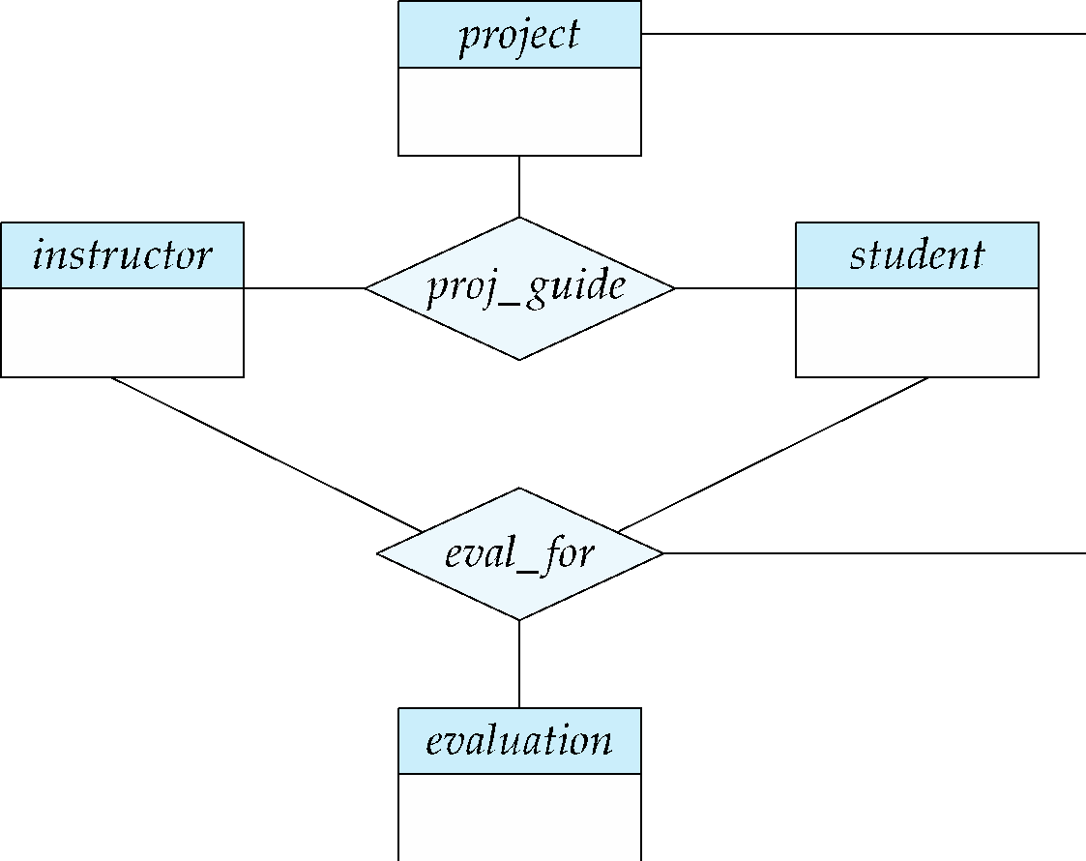
Aggregation
Consider the ternary relationship proj_guide, which we saw earlier
Suppose we want to record evaluations of a student by a guide on a project

Slide 13
Aggregation (Cont.)
Relationship sets eval_for and proj_guide represent overlapping information
  Every eval_for relationship corresponds to a proj_guide relationship
  However, some proj_guide relationships may not correspond to any eval_for relationships
    So we can’t discard the proj_guide relationship
Eliminate this redundancy via aggregation
  Treat relationship as an abstract entity
  Allows relationships between relationships
  Abstraction of relationship into new entity

Slide 14
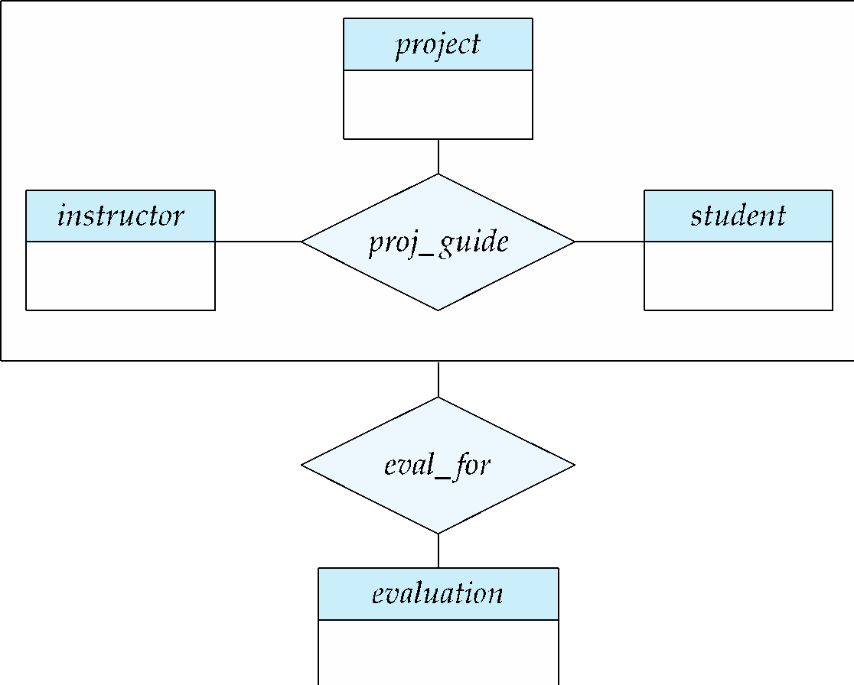
Aggregation (Cont.)
Eliminate this redundancy via aggregation without introducing redundancy, the following diagram represents:
  A student is guided by a particular instructor on a particular project
  A student, instructor, project combination may have an associated evaluation

Slide 15
Reduction to Relation Schemas

Slide 16
Reduction to Relation Schemas
Entity sets and relationship sets can be expressed uniformly as relation schemas that represent the contents of the database.
A database which conforms to an E-R diagram can be represented by a collection of schemas.
For each entity set and relationship set there is a unique schema that is assigned the name of the corresponding entity set or relationship set.
Each schema has a number of columns (generally corresponding to attributes), which have unique names.

Slide 17
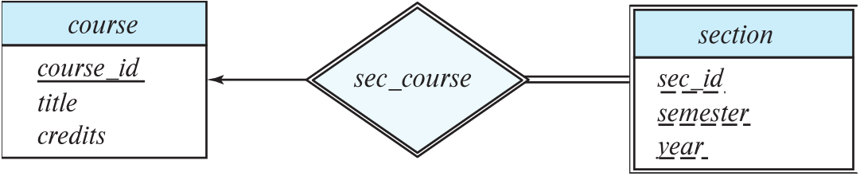
Representing Entity Sets
A strong entity set with simple attributes reduces to a schema with the same attributes
student(ID, name, tot_cred)
A weak entity set becomes a table that includes a column for the primary key of the identifying strong entity set
section ( course_id, sec_id, sem, year )
Example

Slide 18
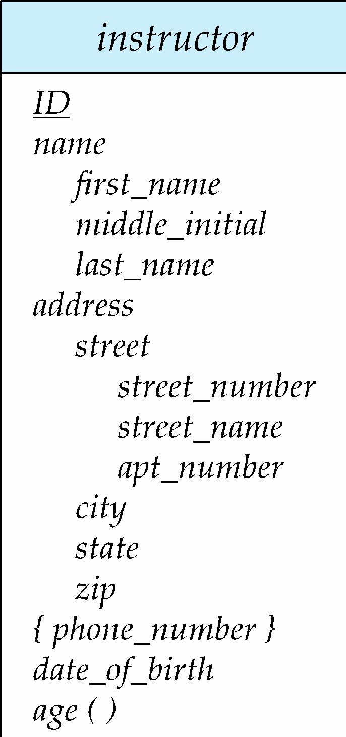
Representation of Entity Sets with Composite Attributes
Composite attributes are flattened out by creating a separate attribute for each component attribute
  Example: given entity set instructor with composite attribute name with component attributes first_name and last_name the schema corresponding to the entity set has two attributes name_first_name and name_last_name
    Prefix omitted if there is no ambiguity (name_first_name could be first_name)
Ignoring multivalued attributes, extended instructor schema is
  instructor(ID,
  first_name, middle_initial, last_name,
  street_number, street_name,
  apt_number, city, state, zip_code,
  date_of_birth)

Slide 19
Representation of Entity Sets with Multivalued Attributes
A multivalued attribute M of an entity E is represented by a separate schema EM
Schema EM has attributes corresponding to the primary key of E and an attribute corresponding to multivalued attribute M
Example: Multivalued attribute phone_number of instructor is represented by a schema:
inst_phone= ( ID, phone_number)
Each value of the multivalued attribute maps to a separate tuple of the relation on schema EM
  For example, an instructor entity with primary key 22222 and phone numbers 456-7890 and 123-4567 maps to two tuples:
  (22222, 456-7890) and (22222, 123-4567)

Slide 20
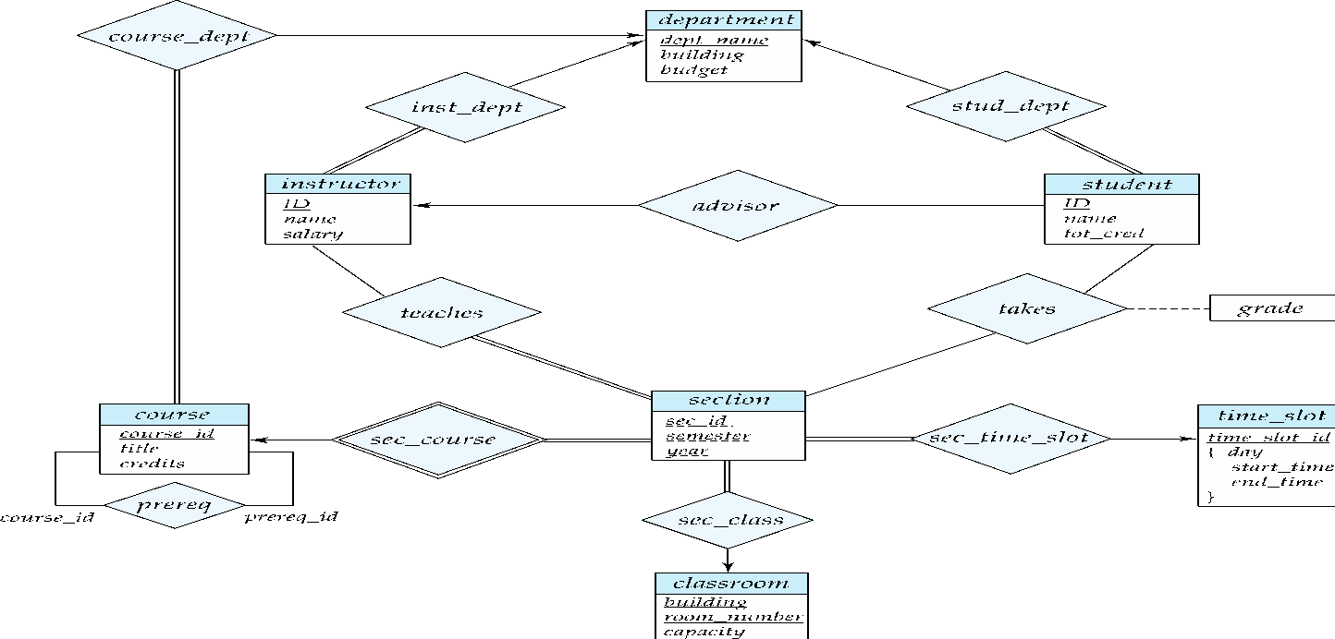
Representing Relationship Sets
A many-to-many relationship set is represented as a schema with attributes for the primary keys of the two participating entity sets, and any descriptive attributes of the relationship set.
Example: schema for relationship set advisor
advisor = (s_id, i_id)

Slide 21
Redundancy of Schemas
Many-to-one and one-to-many relationship sets that are total on the many-side can be represented by adding an extra attribute to the “many” side, containing the primary key of the “one” side
Example: Instead of creating a schema for relationship set inst_dept, add an attribute dept_name to the schema arising from entity set instructor
Example

Slide 22
Redundancy of Schemas (Cont.)
For one-to-one relationship sets, either side can be chosen to act as the “many” side
  That is, an extra attribute can be added to either of the tables corresponding to the two entity sets
If participation is partial on the “many” side, replacing a schema by an extra attribute in the schema corresponding to the “many” side could result in null values

Slide 23
Redundancy of Schemas (Cont.)
The schema corresponding to a relationship set linking a weak entity set to its identifying strong entity set is redundant.
Example: The section schema already contains the attributes that would appear in the sec_course schema

Slide 24
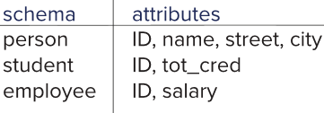
Representing Specialization via Schemas
Method 1:
  Form a schema for the higher-level entity
  Form a schema for each lower-level entity set, include primary key of higher-level entity set and local attributes
  Drawback: getting information about, an employee requires accessing two relations, the one corresponding to the low-level schema and the one corresponding to the high-level schema

Slide 25
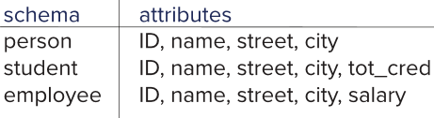
Representing Specialization as Schemas (Cont.)
Method 2:
  Form a schema for each entity set with all local and inherited attributes
  Drawback: name, street and city may be stored redundantly for people who are both students and employees

Slide 26
Representing Aggregation as Schemas
To represent aggregation, create a schema containing
  Primary key of the aggregated relationship,
  The primary key of the associated entity set
  Any descriptive attributes
In our example:
  The schema eval_for is:
  eval_for (s_ID, project_id, i_ID, evaluation_id)
  The schema proj_guide is redundant.

Slide 27
End of Chapter 7

